Slide 1
Introduction to React

Slide 2
React.js fundamentals

Slide 3
What is React.js?
Developed by Facebook
React is a view layer library, not a framework like Backbone, Angular etc.
You can't use React to build a fully-functional web app

Slide 4
Why was React developed?
Complexity of two-way data binding
Bad UX from using "cascading updates" of DOM tree
A lot of data on a page changing over time
Complexity of Facebook's UI architecture
Shift from MVC mentality

Slide 5
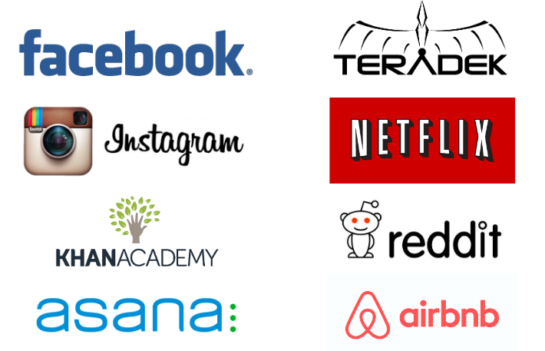
React Users

Slide 6
React: the good
Easy to understand what a component will render
Declarative code → predictable code
You don't really need to study JS in the view file in order to understand what the file does
Easy to mix HTML and JS
You do it already with template libraries (e.g. Handlebars, Mustache, Underscore etc.)
Uses full power of JS
Decoupling templates from logic does not rely on the templates’ primitive abstractions, but uses full power of JavaScript in displaying views
No complex two-way data flow
Uses simple one-way reactive data flow
Easier to understand than two-way binding
Uses less code

Slide 7
React is fast!
Real DOM is slow
JavaScript is fast
Using virtual DOM objects enables fast batch updates to real DOM, with great productivity gains over frequent cascading updates of DOM tree
React dev tools
React Chrome extension makes debugging so much easier

Slide 8
Server-side rendering
React.renderToString() returns pure HTML

Slide 9
React: the bad
React is nothing but the view
No events
No XHR
No data / models
No promises / deferreds
No idea how to add all of the above
Building JSX requires some extra work
But most of the work is already done for you by react-tools
No support for older browsers
React won't work with IE8
There some polyfills / shims that help

Slide 10
Why should I use React?
Easy to read and understand views
Concept of components is the future of web development
If your page uses a lot of fast updating data or real time data - React is the way to go
Once you and your team is over the React's learning curve, developing your app will become a lot faster

Slide 11
Is switching to React easy?
Understanding how it works will take time and will slow you down at first (but once you and your team get it, things will start happening much faster)

Slide 12
Component
Components are self-contained reusable building blocks of web application.
React components are basically just idempotent functions (same input produces same output).
They describe your UI at any point in time, just like a server-rendered app.
Created using React.createClass()
The only required method is render()
Inserted into DOM using React.renderComponent()

